Slide 1
Understanding the Minimax Algorithm Using Connect Four
Presented by Alex Frear

Slide 2
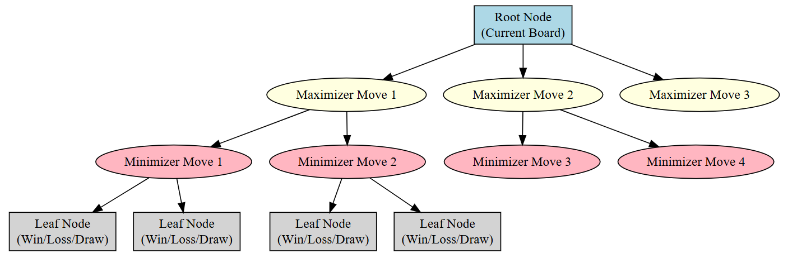
Introduction to Minimax
The Minimax Algorithm is used in turn-based, two-player strategy games.
It assumes both players play optimally to maximize their advantage.
Commonly used in AI for board games, decision trees, and strategy simulations.

Slide 3
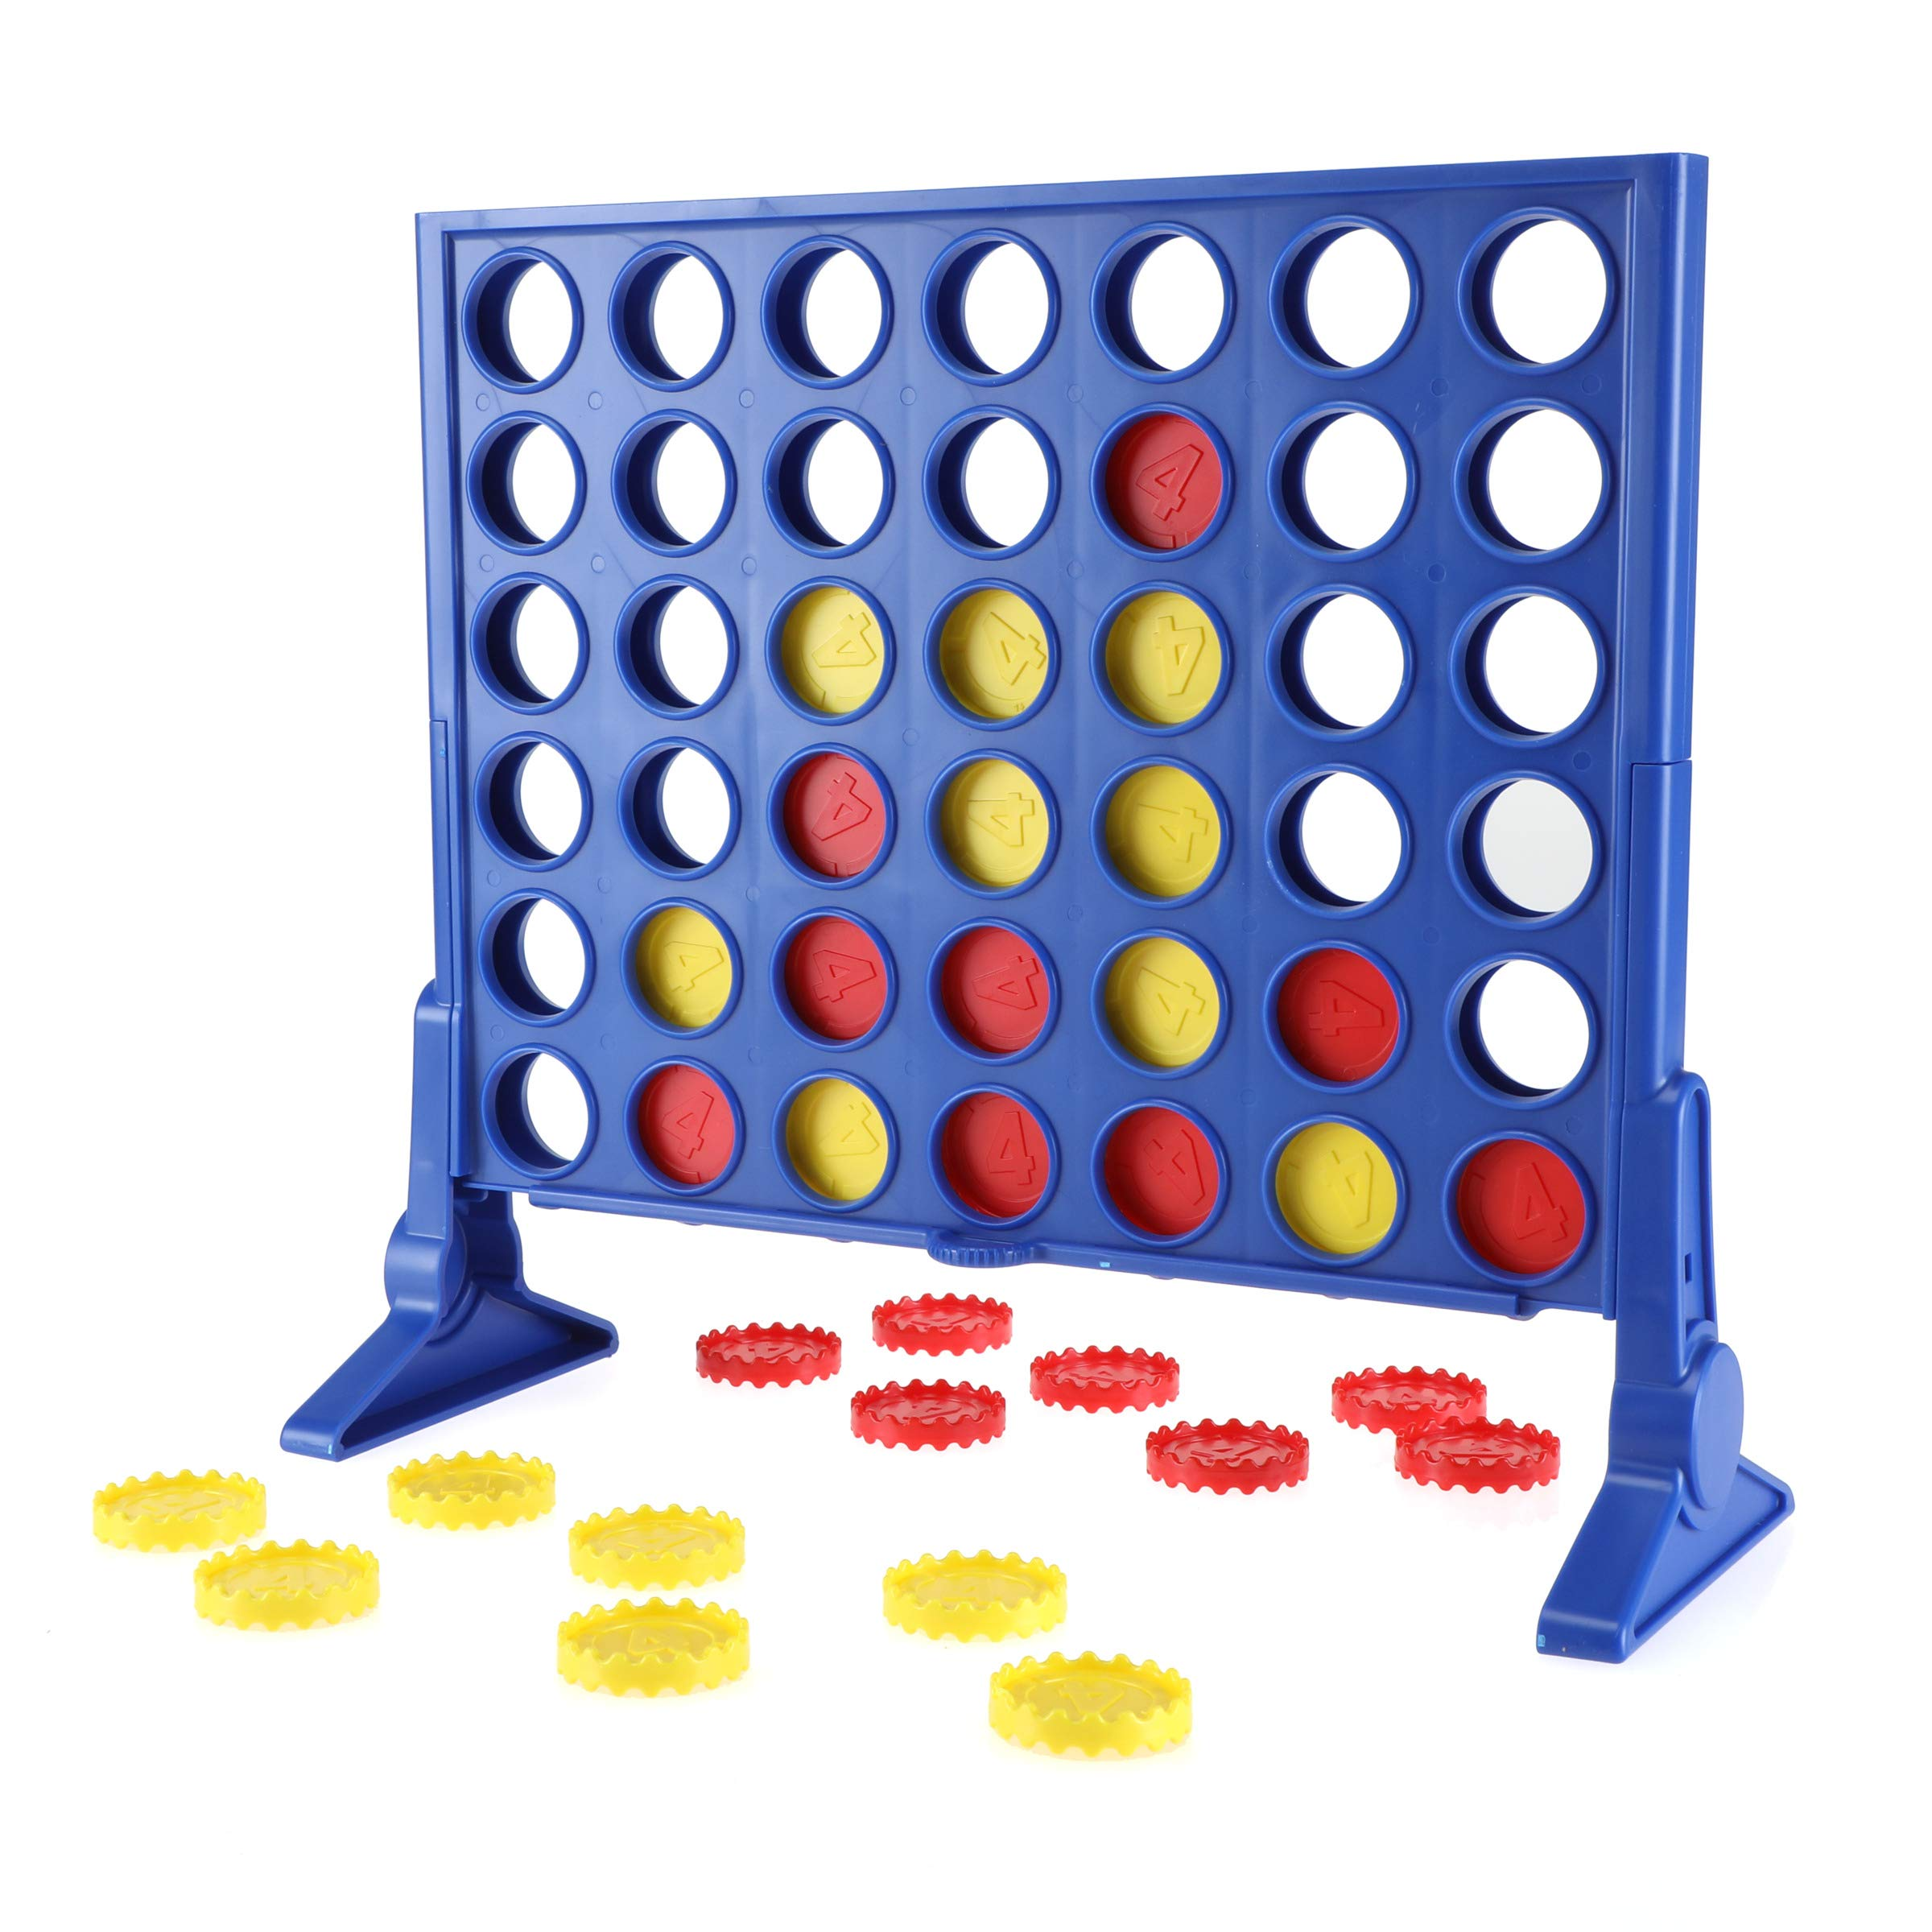
Why Connect Four?
Connect Four is a perfect example for Minimax because:
It has a fixed grid (7 columns × 6 rows).
Players take turns dropping pieces into columns.
The goal is to connect 4 pieces in a row (horizontally, vertically, or diagonally).
The branching factor (b) is at most 7 (one move per column), making it computationally
more complex than Tic-Tac-Toe.

Slide 4
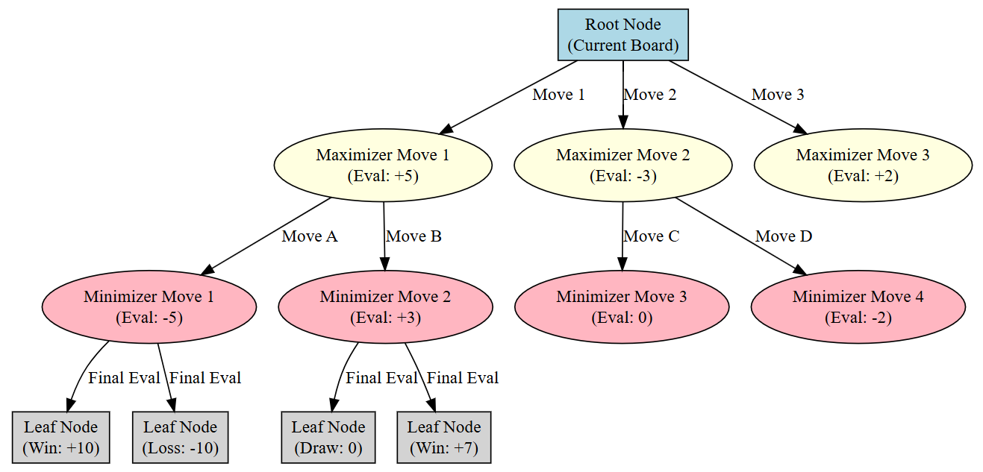
How Minimax Works in Connect Four
Generate the Game Tree
The algorithm explores all possible moves and outcomes.
Assign Scores to Terminal States
+1 for a win, -1 for a loss, and 0 for a draw.
Backpropagation
The Maximizing Player (AI) picks the move with the highest score.
The Minimizing Player (Opponent) picks the move with the lowest score.

Slide 5
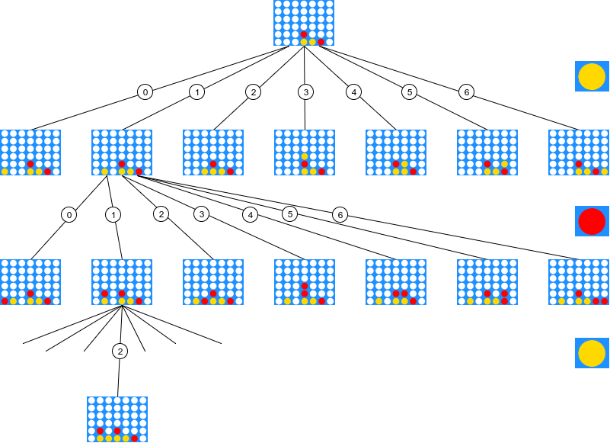
Minimax Move in Connect Four
Assume the board is partially filled.
The AI (Maximizer) must decide the best move.
The algorithm evaluates:
Winning moves first.
Blocking opponent’s winning moves.
Setting up a future win.

Slide 6
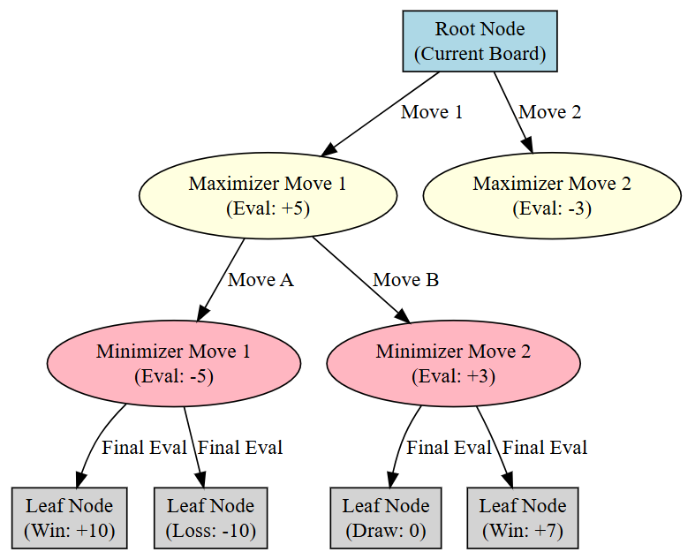
Minimax with Depth Limitation
Problem: Searching the full game tree is computationally expensive.
Solution: Limit the depth of the search.
Instead of evaluating only win/loss states, use a heuristic evaluation function to assign scores.
Example Heuristic Function:
+100 for a winning move
-100 for a losing move
+10 for a potential 3-in-a-row
-10 for blocking opponent’s 3-in-a-row

